Slide 1
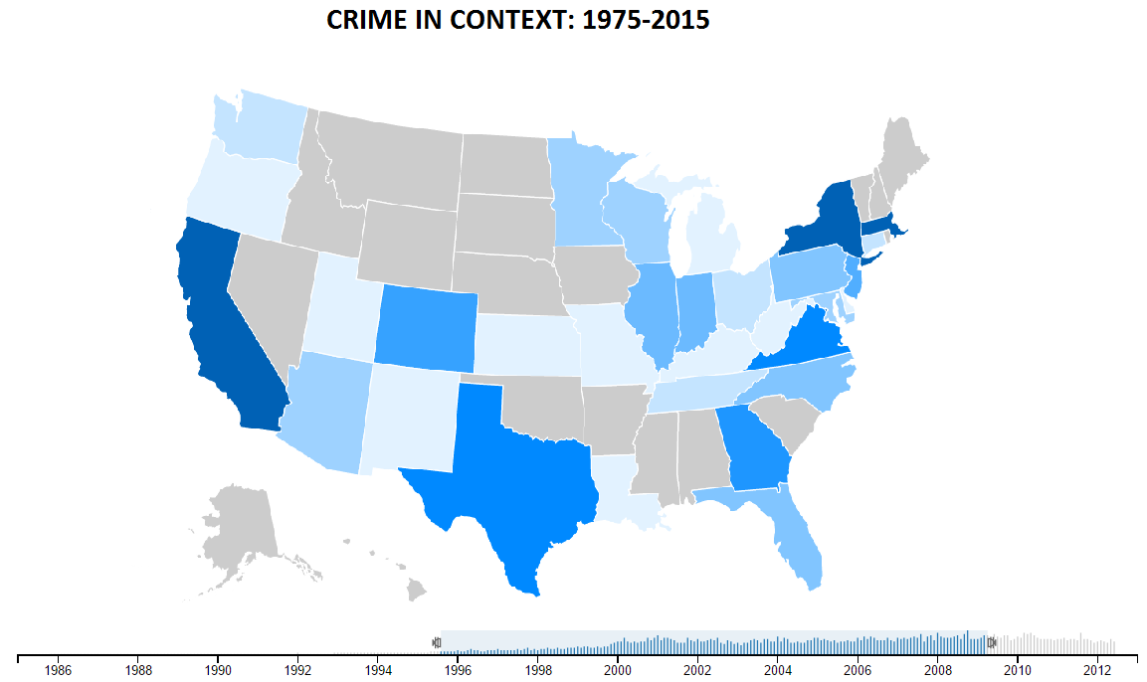
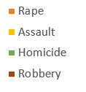
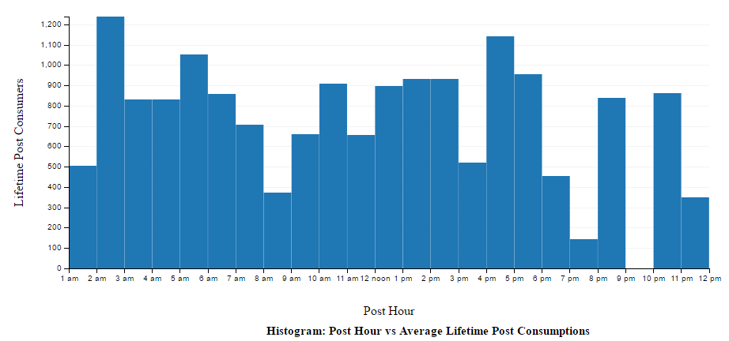
Select Parameter:
Total Crimes (default)
Crimes per capita
Color Legend
Crime distribution by States (color: total number of violent crimes)
Population vs Average Number of Crimes

